Slide 1
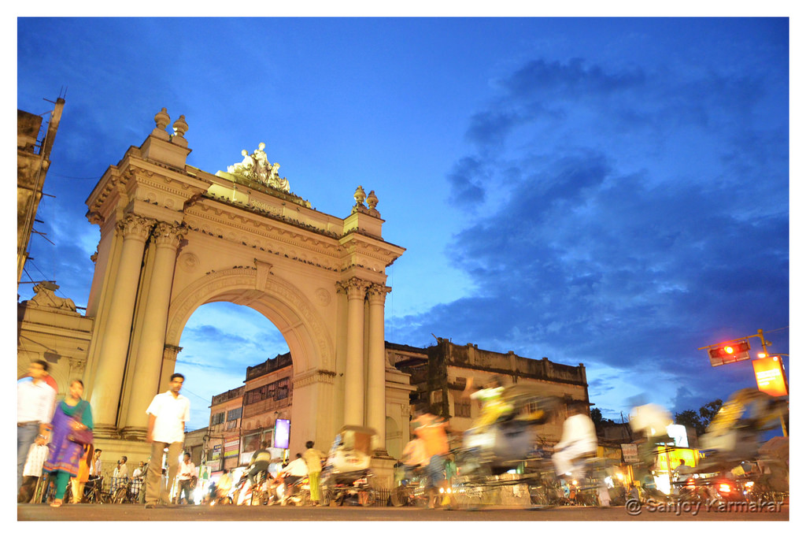

Tourist Attractions of Burdwan
Dept. of Geospatial Science
University of Burdwan

Slide 2
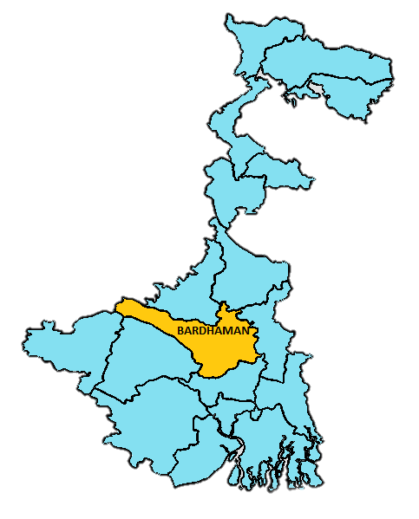
A district of West Bengal state in Eastern India.
History of the city can be traced back to 5000 BC.
Population is about 509,856 (2016 census).
Tropical Savanna Climate.
Chief rivers are the Damodar and the Banka
Official languages are Bengali, Hindi, English
Website: www.bardhaman.gov.in

Slide 3
Major Attractions

Slide 4
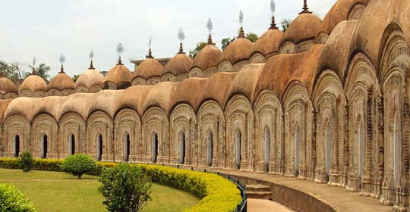
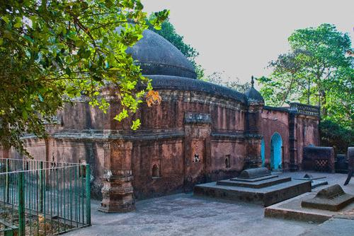
108 Shiva Temple
A complex comprising of 108 deities of Lord Siva housed in 108 temples in picturesque surroundings , a beautiful garden and a lake , constructed by Maharani Bishnu Kumari.
(Burdwan - I Block)
Tomb of Sher Afghan
Subject of Akbar the Great & Kutubuddin, Subedar of Bengal. Alamgunge, (Burdwan Municipality)

Slide 5
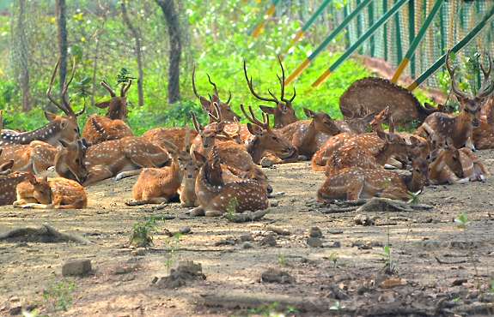
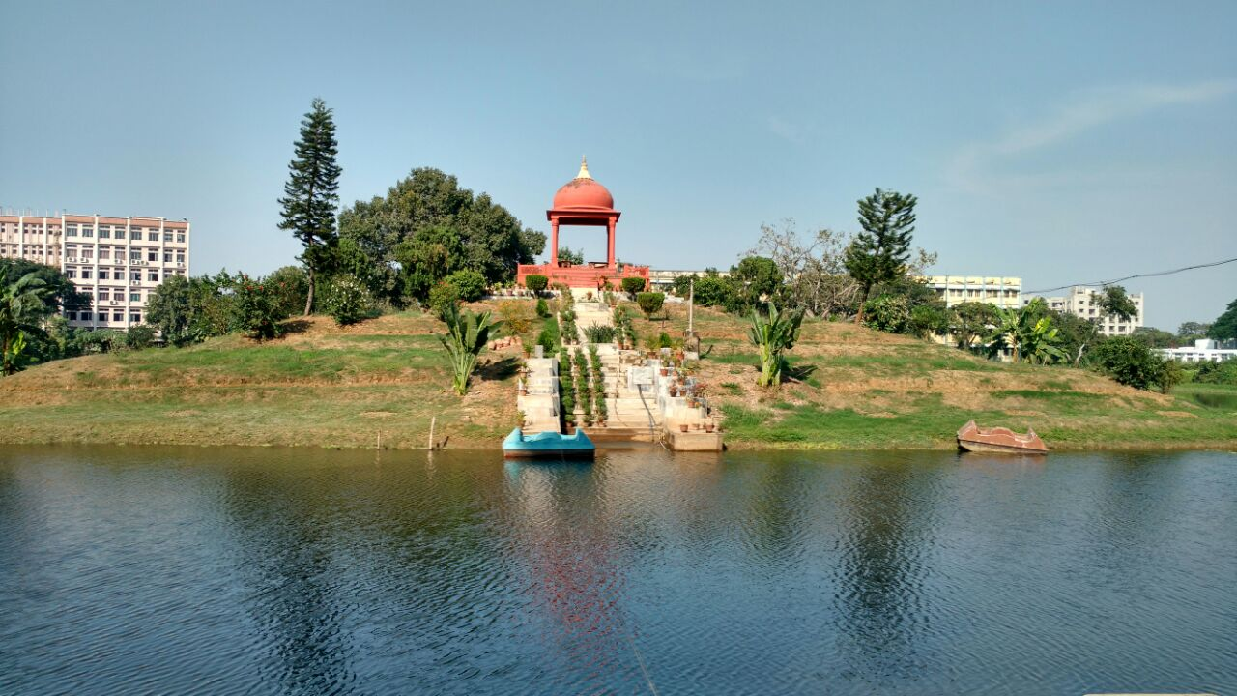
Deer Park
A forest reserve that is noted for the number of deer housed, situated opposite the University of Burdwan
Golapbag
A Botanical and Zoological garden established in 1884 by King Bijoy Chand Mahatab, is heralded as the Garden of Rose, situated inside the University of Burdwan

Slide 6
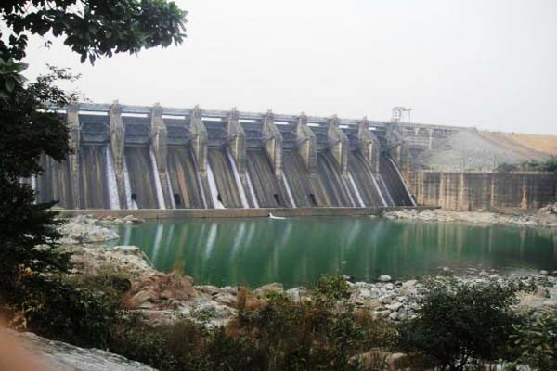
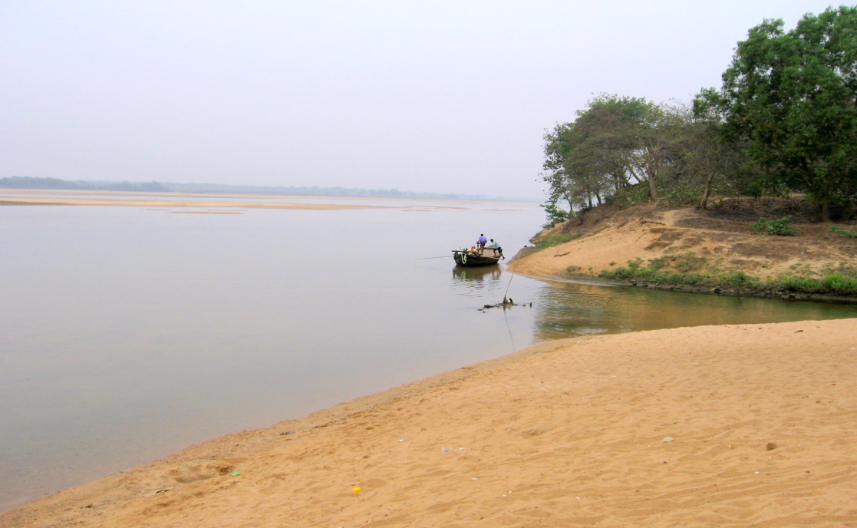
Maithon Dam
Situated in Maithan, a famous picnic spot
Damodar River side
There is a bridge over Damodar at Sadarghat which is known as Krishok Setu. The sandbanks by the river are ideal for picnics, whereas, boat rowing can be enjoyed on the waters of the river. A kite flying fair takes place on the banks on the month of January

Slide 7
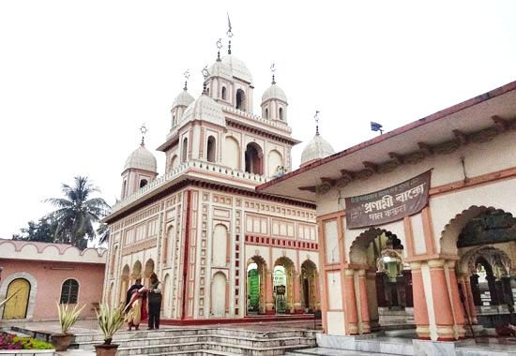
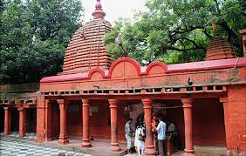
Sarbamangala Kali Temple
situated in Pairakhana was established in 1740 A.D. by the king Kirti Chand while the temple structure was built by king Mahatab Chand.
Kalyaneshwari Temple
A 500 year old temple is located on the banks of Barakar river

Slide 8
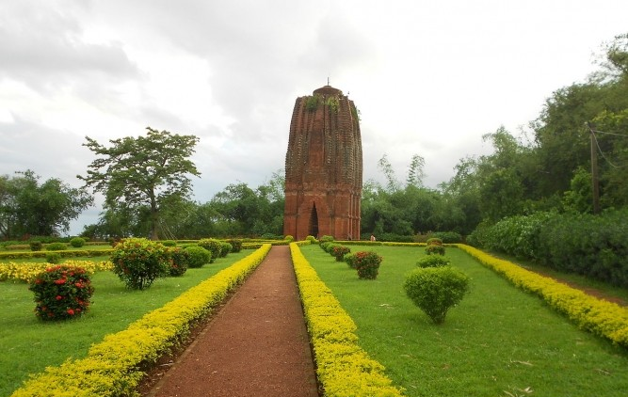
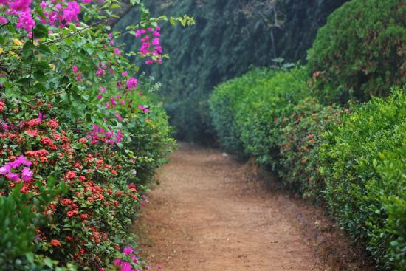
Sat Deul Temple
located in Deule, this brick-Temple shows the features of the Nagara style. The ground plan is pancha-ratha, surmounted by a curvilinear tower. The temple has stucco works over carved bricks. Jaina sculptures found at the place may indicate that it belonged to the Jaina faith and the temple is datable to c. 10th-11th century A.D.
Bhalki Machan Garden
A long drive away from the city, this getaway on the edge of a deciduous forest is the perfect spot to laze around for a day or two. According to a legend, a tunnel beneath the machan leads straight to a secret passage opening at the Rajbari in Burdwan, about 25km away.

Slide 9
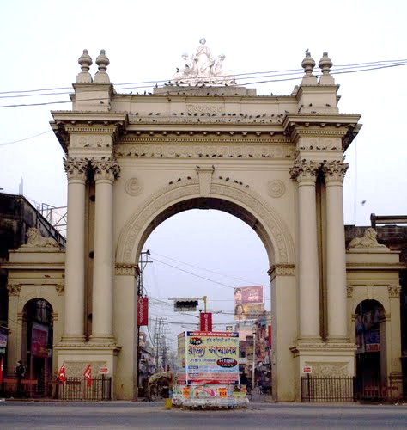
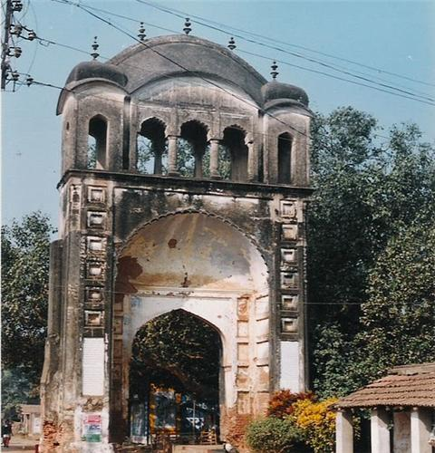
Curzon Gate
located on the BC Road The majestic Curzon Gate was famously erected in 1903, by the king of Burdwan Maharaja Bijoy Chand Mahatab to celebrate Lord Curzon's visit.
Baroduari
Refers to the twelve gates built by Maharaj Kirtichand

Slide 10
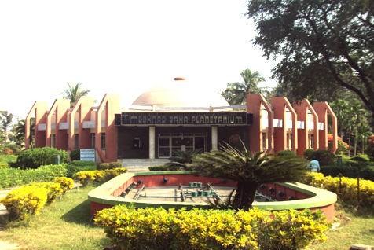
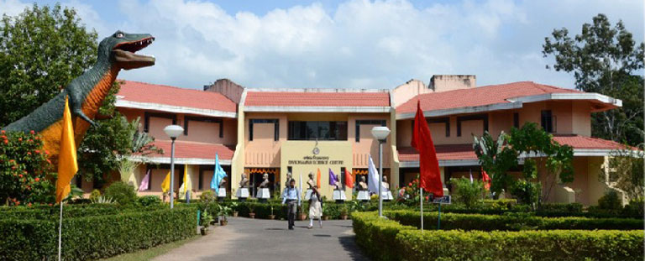
Meghnad Saha Planetarium
Situated on the University Road, was constructed by the famous Japanese Goto, an optical manufacturing company. Inaugrated in 1994
Science Centre
Situated on the University Road, the centre offers The prominent exhibition of the centre includes the mystery behind flying objects, game of moving balloons and balls, wonders of chemistry and many more.

Slide 11
Thank You

